Slide 1
Technology & Employment
for People Who Are Blind or Visually Impaired
www.TampaLighthouse.org

Slide 2
People who are blind or visually impaired can be
employed in a variety of competitive jobs alongside sighted peers.

Slide 3
Did You Know?
Thanks to assistive technologies and training programs, Tampa Lighthouse helps them attain these goals every day.
Many blind or visually impaired individuals want to enter the workforce or remain working after vision loss.

Slide 4

Job Development
Loyalty
Why hire a
Tampa Lighthouse
Client?
Work ethic
Specialized training

Slide 5

Employment Services
Vocational Evaluation
Computer Training
Supported Employment
Job Placement
Rehabilitation
Engineering
Job
Development

Slide 6
Vocational Evaluation
Assessment of interests, aptitudes, abilities and behaviors.
Exploration of work preferences and goals.
Development of individual vocational plans.

Slide 7
Vocational Evaluation
Client vocational plans take into consideration:
Comprehensive assessment
Vision & hearing reports
Medical & psychological reports
Education
Work history

Slide 8
Computer Training
Adaptive equipment and assistive software help blind and visually impaired individuals learn popular office applications including:
Word™
Excel™
Internet
Email

Slide 9
Rehabilitation Engineering
Rehabilitation engineering assesses the need for:
Adaptive equipment
Assistive devices like …
(continued on next slide)

Slide 10
Rehabilitation Engineering
Assistive devices:
Magnification equipment, stand-alone or with a computer
Zoomtext or Magic: magnifies fonts on the computer
Computer programs that talk (JAWS)
Closed Circuit TV’s (CCTV’s)

Slide 11
Employer Services
Work site analysis
Consultation about reasonable job modifications
Recommendations to increase retention and advancement
Tampa Lighthouse finds appropriate employment and partnerships for our clients. Services for Employers include:

Slide 12
Employer Services
Tampa Lighthouse
Serves:
Tampa Lighthouse offers Support For:
Large businesses (enterprise)
Small businesses
(1 – 250 employees)
Government agencies
Americans with Disabilities Act (ADA)
Section 508 of the Rehabilitation Act

Slide 13
Lighthouse Technology Services
Tampa Lighthouse can help with the following needs:
Accessibility Consulting
Accessibility Audits and Testing
Section 508 Consulting and Technical Assistance
Accessibility Technology Solutions
Website Assessment
Document and Form Assessment
Accessibility Training and Awareness
Technical Support Services

Slide 14
Supported Employment
Tampa Lighthouse offers employer and employee assistance with:
Securing transportation
Job-readiness skills
Adaptive or assistive equipment
Job-seeking skills
Regular follow-up with employer and employee

Slide 15

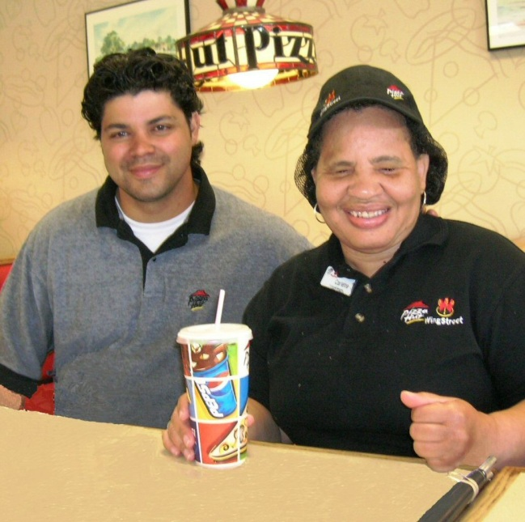
Employment Opportunities
Individuals who are blind or visually impaired work in …
Retail Stores
Restaurants

Slide 16
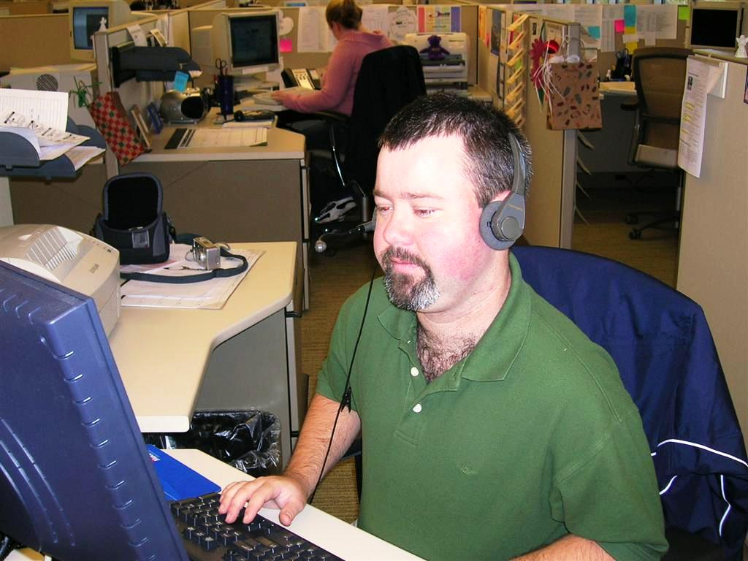
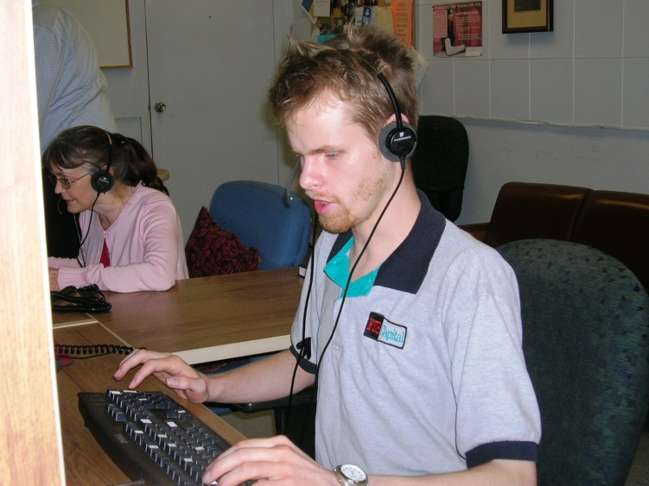
Employment Opportunities
Financial Institutions
Call Centers

Slide 17
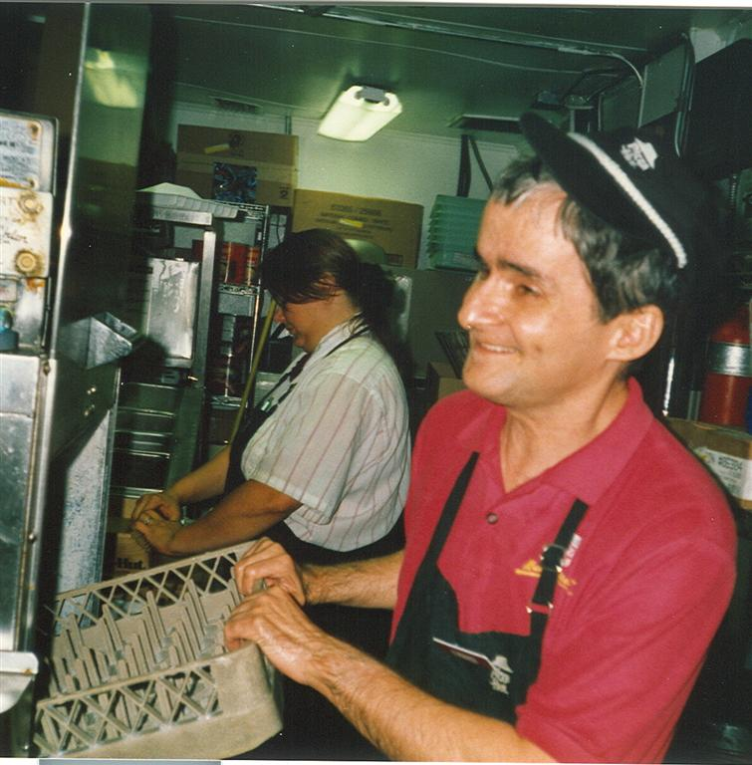
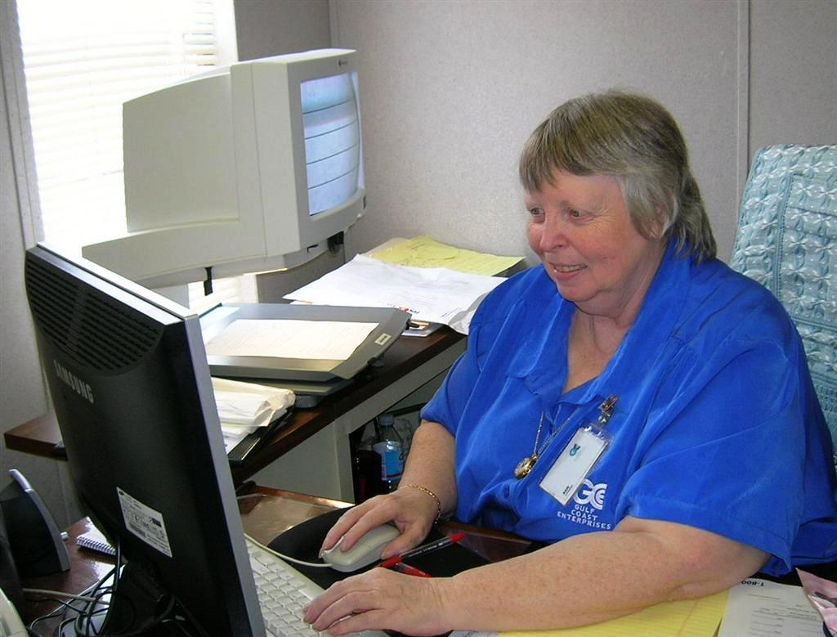
Employment Opportunities
Hospitality
Administration

Slide 18
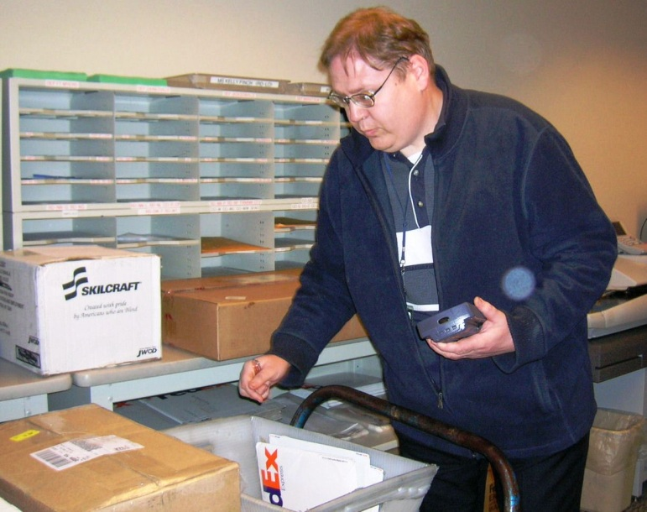
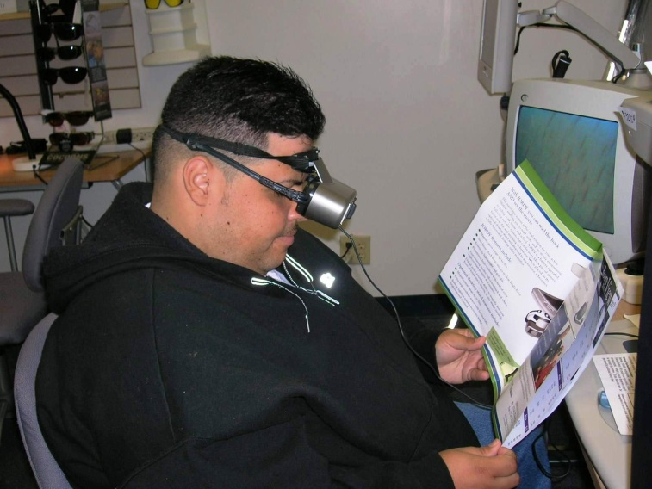
Employment Opportunities
Mail Rooms
Technology Centers

Slide 19

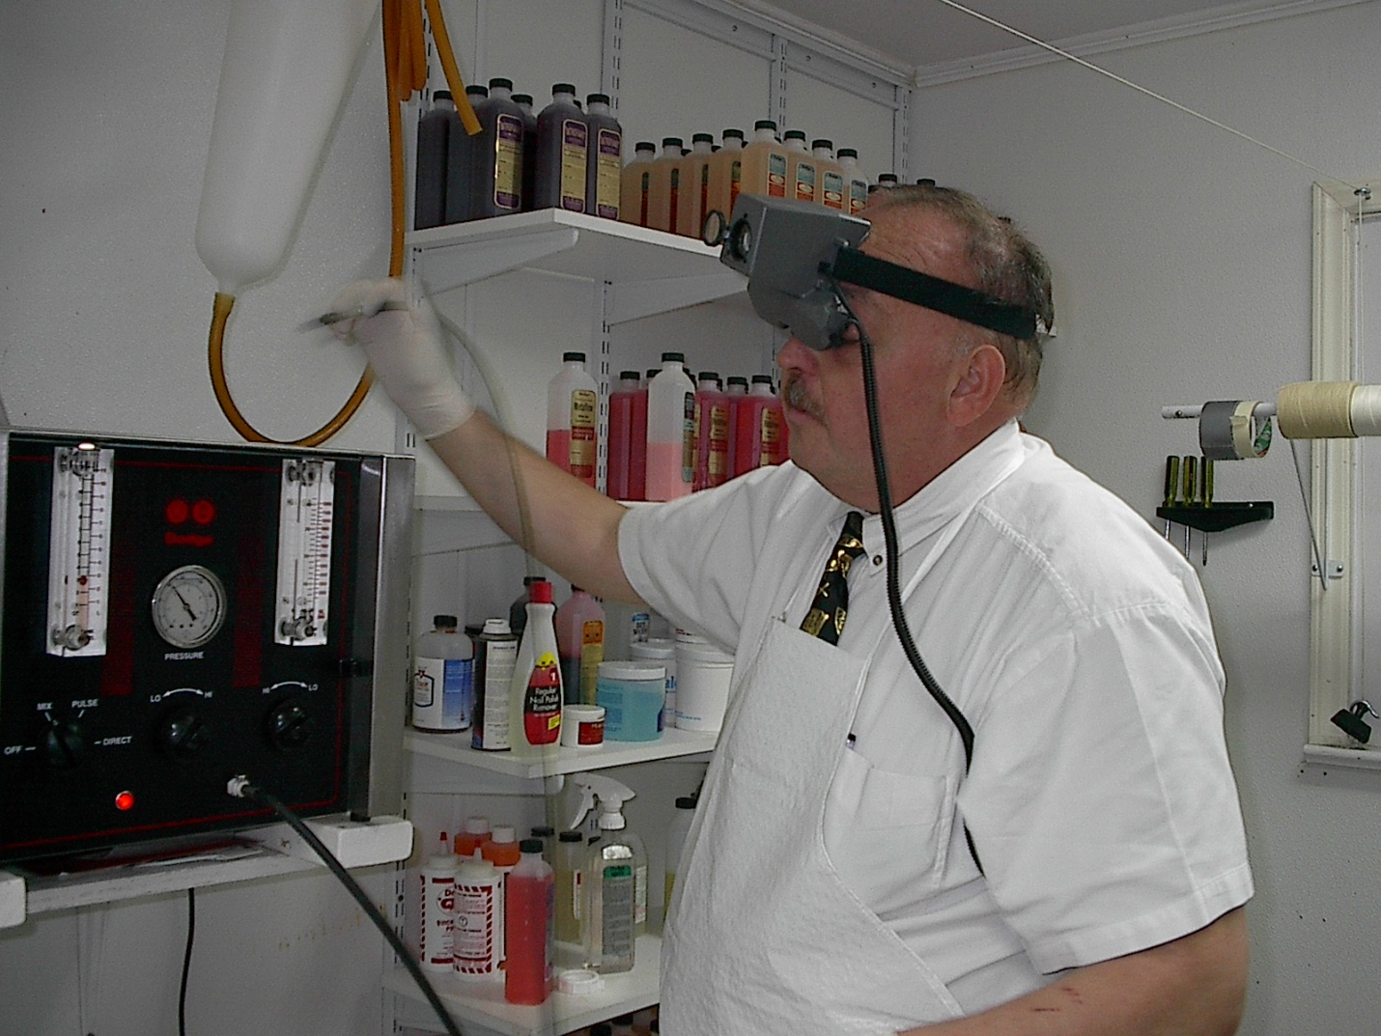
Employment Opportunities
Nursing Homes
Medical Facilities

Slide 20


Community Support
Tampa Lighthouse for the Blind’s employment programs are funded with support from the United Way of Tampa Bay and the Division of Blind Services.

Slide 21
For More Information
To find out how we can help you meet your staffing or employment needs contact us toll-free at
1-866-251-2407
www.TampaLighthouse.org

Slide 22

Thank You
This presentation is made possible through the generous support of the Children’s Board of Hillsborough County

Slide 23
www.TampaLighthouse.org
1106 W. Platt Street Tampa, Florida 33606
(813) 251-2407
206 Avenue D N.W. Winter Haven, Florida 33881 (863) 299-3633

